Slide 1
Jeroen Willemsen
Why Manual Verification Still Matters

Slide 2

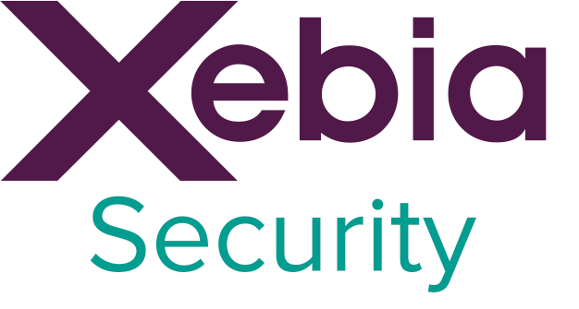
About me
Jeroen Willemsen
@commjoenie
jeroen.willemsen@owasp.org
“Security architect”
“Full-stack developer”

Slide 3

GOAL of Today:
Help you on the next step of your security journey

Slide 4
Index
The application in its runtime
The container up close
The container on its platform
The way forward

Slide 5

Why?

Slide 6

Notes:
Your application!
Your infrastructure!
Your code!
Your information!
Your users!
Your functionality!

Slide 7
Index
The application in its runtime
The container up close
The container on its platform
The way forward

Slide 8
Vulnerabilities
Vulnerabilities
Your application
3rd party libs
Appcode
Bad practices
Runtime

Slide 9
3rd party libs
Start with a dependency checker!
Start manual.
Learn how to verify and how to “fix” it
Suppression, replacement, harden/add guards.
Automate and keep rechecking.

Slide 10
3rd party libs
Not all ecosystems have proper checkers.
Not finding a CVE does not mean it is not there.
Libraries still need vetting.
Especially: Internal “libraries” need your own vetting!
What if it only takes 1 Class?

Slide 11
Appcode
SAST tooling mileage will vary depending on the language, framework & tooling
Always have linters on board!
Start manual before automation
Have explainable suppression in place
Test before buy
Notes:
SAST mileage varies due toe:
-

Slide 12
Appcode
Create your own tool / extend existing tools if necessary
Use GREP!
Manual reviews are king!
Missing authorization? Disclosing information in an error?

Slide 13
Your application
Appcode
3rd party libs
Runtime
Want to know how your backends behave in general?
DAST will
help finding missing headers;
detect some of the obvious missed XSS/SQLI;
create a lot of false positives;
create a lot of false negatives due to reach and recoginition.

Slide 14
Your application
Appcode
3rd party libs
Runtime
Don’t want to burn yourself against an earlier finding?
Write a security test
Write security tests based on evil user stories.

Slide 15
Index
The application in its runtime
The container up close
The container on its platform
The way forward

Slide 16
Your container
Layer: Your application
Layer: OpenSSL
Heartbleed?
Misconfiguration
Layer: glibc
Vulnerabilities in older base image
Base Layer: Linux OS

Slide 17
Your container
Layer: Your application
Layer: OpenSSL
Analyzing layers for vulnerabilities with Clair/Anchore gives great first insight
Start manual, then automate
Keep retesting: a CVE might pop up in a later stage.
Focus on base-images!
But what about unknown binaries?
Layer: glibc
Base Layer: Linux OS

Slide 18
Your container
Layer: Your application
Layer: OpenSSL
What about configuration mistakes?
Lynis/inspec to the rescue.
Create your own target profile!
Focus on base-images and verify on change!
Profiles require maintenance.
Layer: glibc
Base Layer: Linux OS

Slide 19
Your container
Layer: Your application
Layer: OpenSSL
What about configuration mistakes?
Dockle/hadolint on a syntax level.
Focus on base-images and verify on change!
It might not find your private key in the container.
Layer: glibc
Base Layer: Linux OS

Slide 20
Index
The application in its runtime
The container up close
The container on its platform
The way forward

Slide 21
Other container
Your container
Your container
Insecure configuration
Bad practices in K8S, Mesos/Marathon
Docker daemon &
abstraction layers
Security issues in host
Your host operating system

Slide 22
Other container
Your container
Your container
Docker daemon &
abstraction layers
Your host operating system
Take the hygiene steps first:
CIS Benchmarks through Inspec/ciscat
Lynis/Openscap on your system
Check for vulnerabilities: OpenVAS or Nessus
Other commercial tools

Slide 23
Other container
Your container
Your container
Docker daemon &
abstraction layers
Your host operating system
Immutability is king
Fat hosts often have too much attack surface out of sight
The richer the host, the more checking is required

Slide 24
General issues
Secrets leaked
Network issues
IAM issues
“Cloud” hosting configuration
Notes:
Compromised source code: break integrity / break confidentiality!
Data Breaches: Barbarians in the Throne Room
Dave Lewis

Slide 25
Secrets leaked
Start with the sources (trufflehog)
Check the containers (grep, tooling)
Check the virtual machine images
Check the runtimes
Check the CI/CD pipeline
VALIDATE the process, then the tooling

Slide 26
Network issues
Keep it simple: start by “deny by default”
Start as managed as possible: cloud providers offer tooling
Not in the cloud? Use tools like nmap
TLS and such? Use checkssl.sh and alike
Allways check for “unexpected” infiltration/exfiltration paths.

Slide 27
IAM issues
Different environments require different tools
Application level
Host level
Cloud provider level
When is something too broad? When is something too fine grained?
Still you will need manual reviews for compliance and toxicisity.
User having access to all environments

Slide 28
“Cloud” hosting configuration
Various cloud providers have their own tooling ecosystem
Cloud custodian is “cross-cloud”
Using terraform? Check tools like terraform-compliance
Run them on every check
Manual verification of effective cloud configration is always necesseary
The too open network design?

Slide 29
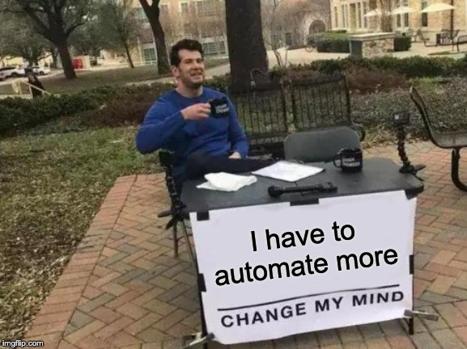

Slide 30
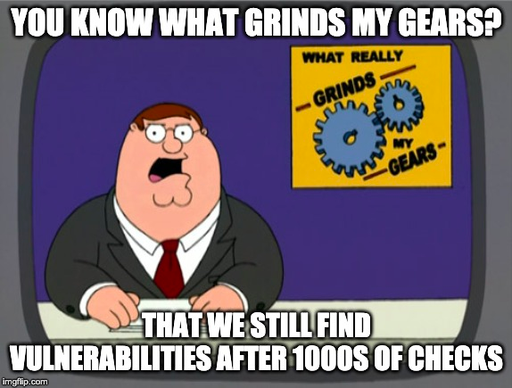

Slide 31
Index
The application in its runtime
The container up close
The container on its platform
The way forward

Slide 32
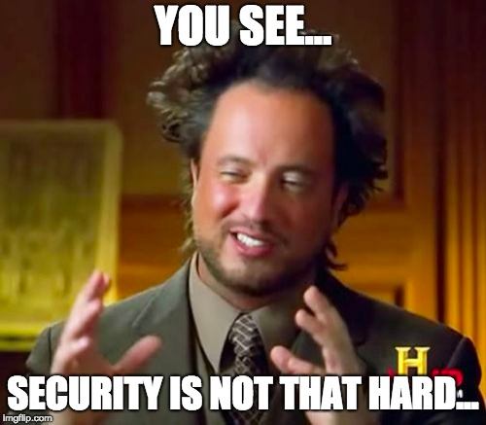
The Way Forward
Automate as much as you can!
Manual verification matters:
We cannot catch every mistake
We learn about “new mistakes”
Take risk based actions: it’s easy to drown in the pool of todo’s.

Slide 33
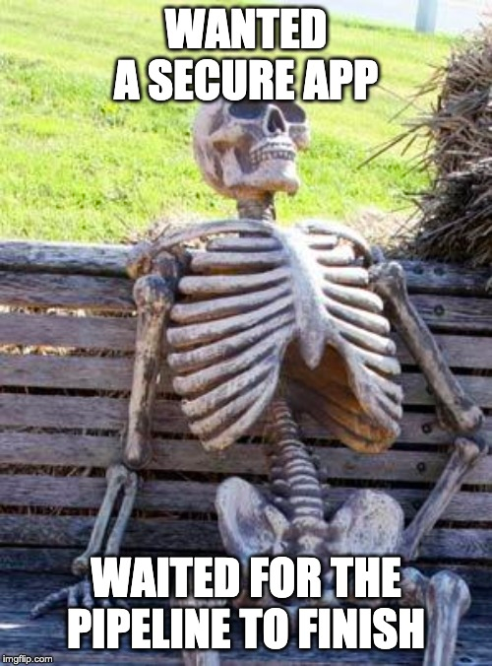
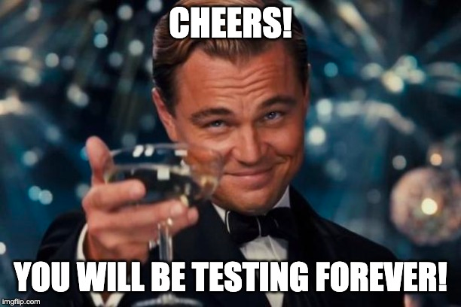
Questions?
@commjoenie
jeroen.willemsen@owasp.org

Slide 34
Thank you!
@commjoenie
jeroen.willemsen@owasp.org

Slide 35
